Slide 1
RBC – Wealth Management
Date: March 14, 2018

Slide 2








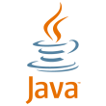
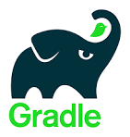


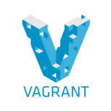




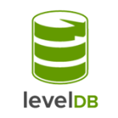

Technology Stack On premises workstation setup Fabric vs Corda
Hyperledger - Fabric 1.0
User Interface | API | Blockchain Network | Smart Contract | Deployment
R3-Corda 1.0
UI/ CordApp | Blockchain Network | Smart Contract | Build/ Deployment
Node Communication: Peer-Peer Broadcast, HTTP2/gRPC
Node Communication: Point-to-point, AMQP1.0

Slide 3
Development Platforms and Toolset
 | Hyperledger-Fabric | R3-Corda
OS | Ubuntu Desktop | Windows / Ubuntu Desktop
SCM | GIT | GIT
IDEs | Eclipse-Mars ATOM, VS Code | IntelliJ
Lang/ Frameworks | Fabric 1.0 GO Lang Node JS | Corda-1.0 Kotlin
Common frameworks and tools | JDK 8 and above, Spring, AngularJS, BootStrap, Postman, Junit, Mockito, Cucumber, GitBash CLI
Dev Tools | Fabric-Composer, Fabric Playground Node, NPM , Python 2.7 Yeoman, Mocha/Chai, JSLint, ESLint | Korda DSL
Compile / Build | Gradle, NPM | Gradle
Package | Docker | Docker
Deploy | AWS/Azure
Agile/ALM Tools/DevOps | JIRA, Jenkins

